Slide 1
WINTER SEASON AVG MAX TEMP ANALYSIS
Temperature Values at each station
Time period: 1991 to 2023
Daniel Field Time period: 1998 to 2023

Slide 2
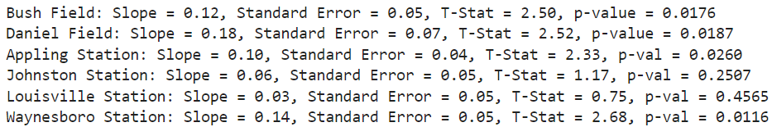
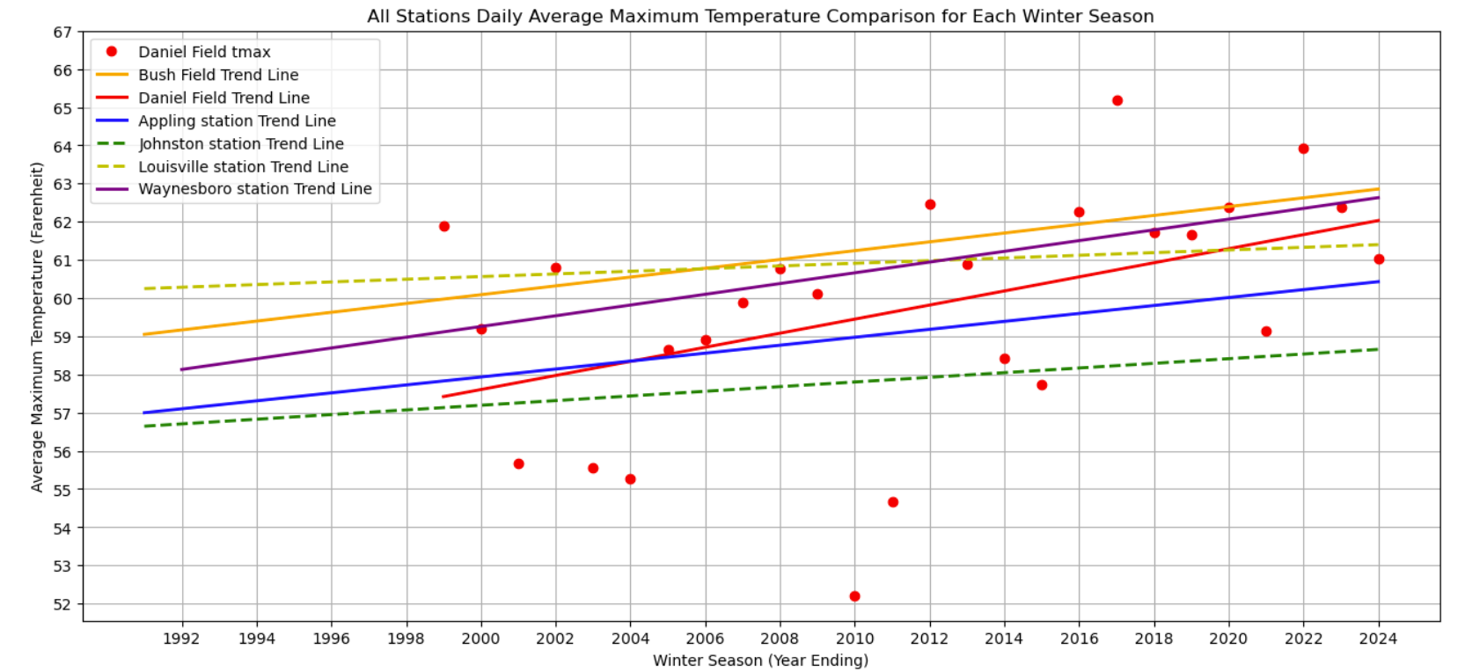

Slide 3
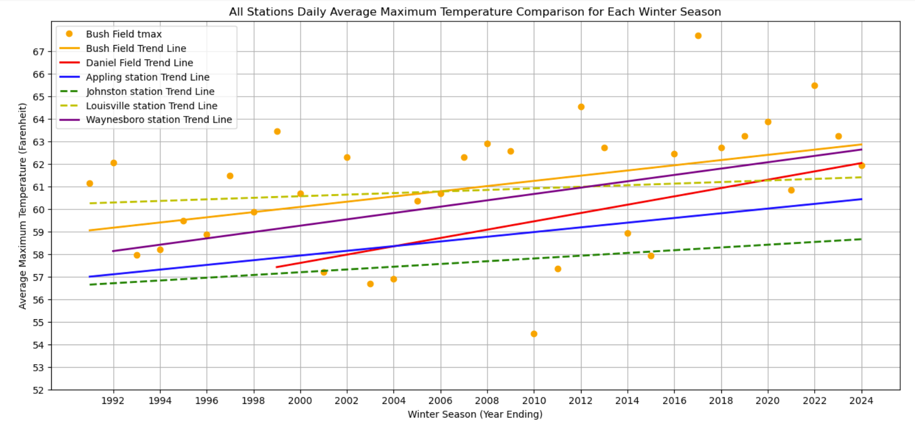

Slide 4
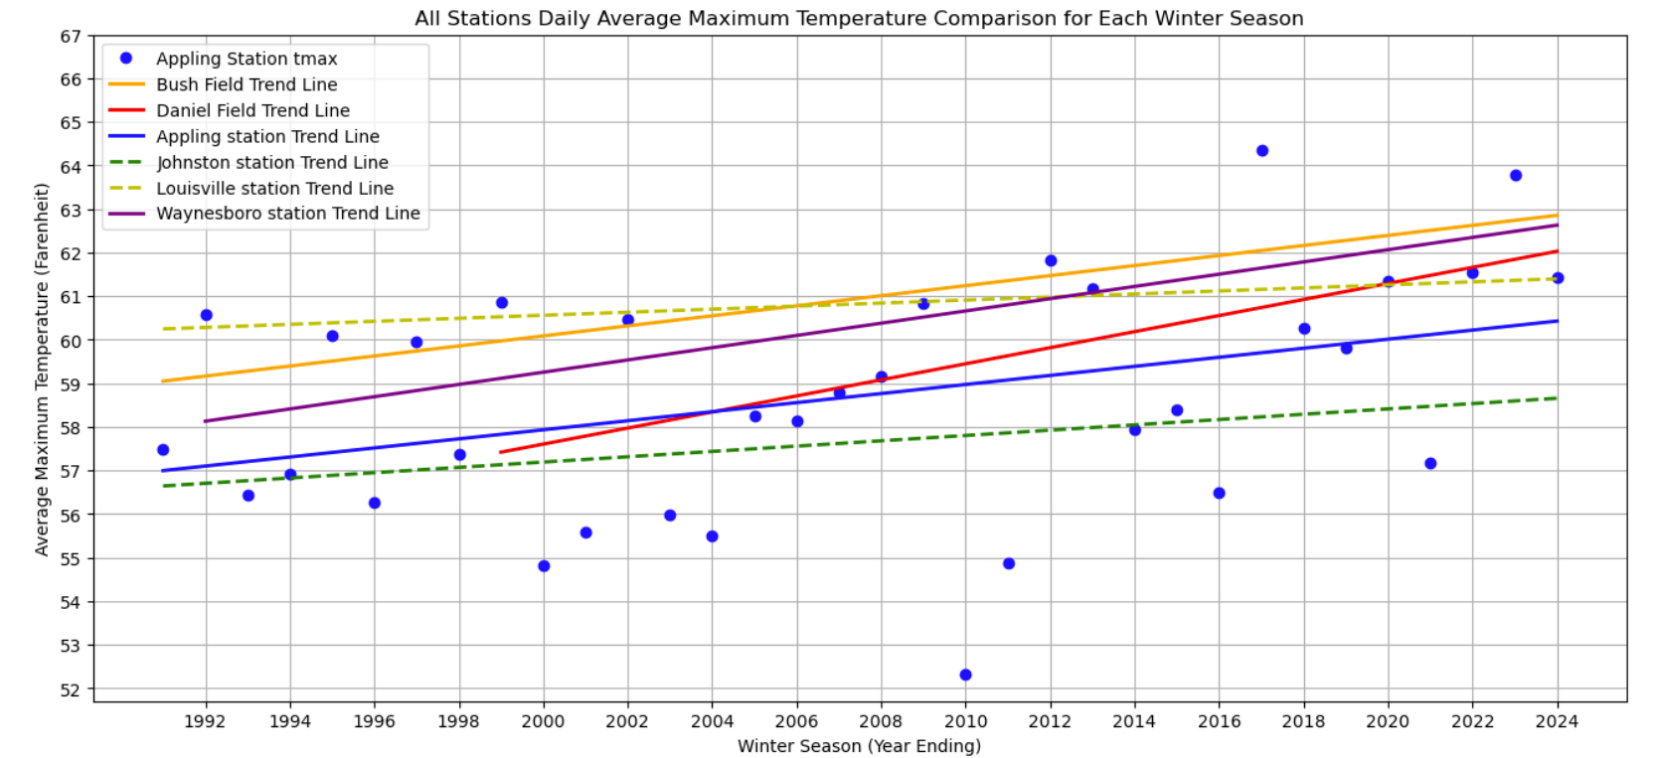

Slide 5
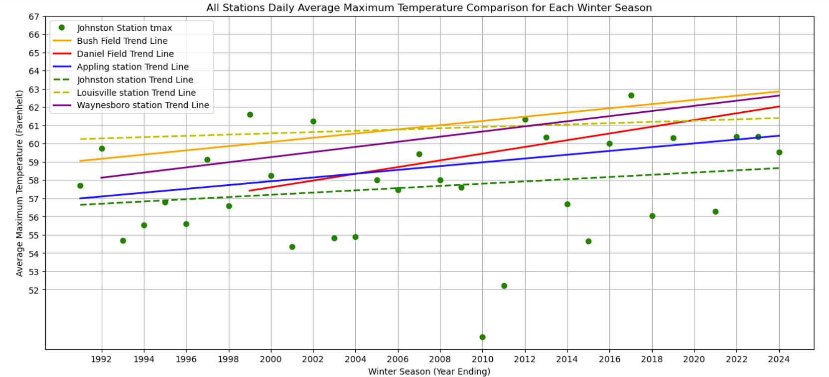

Slide 6
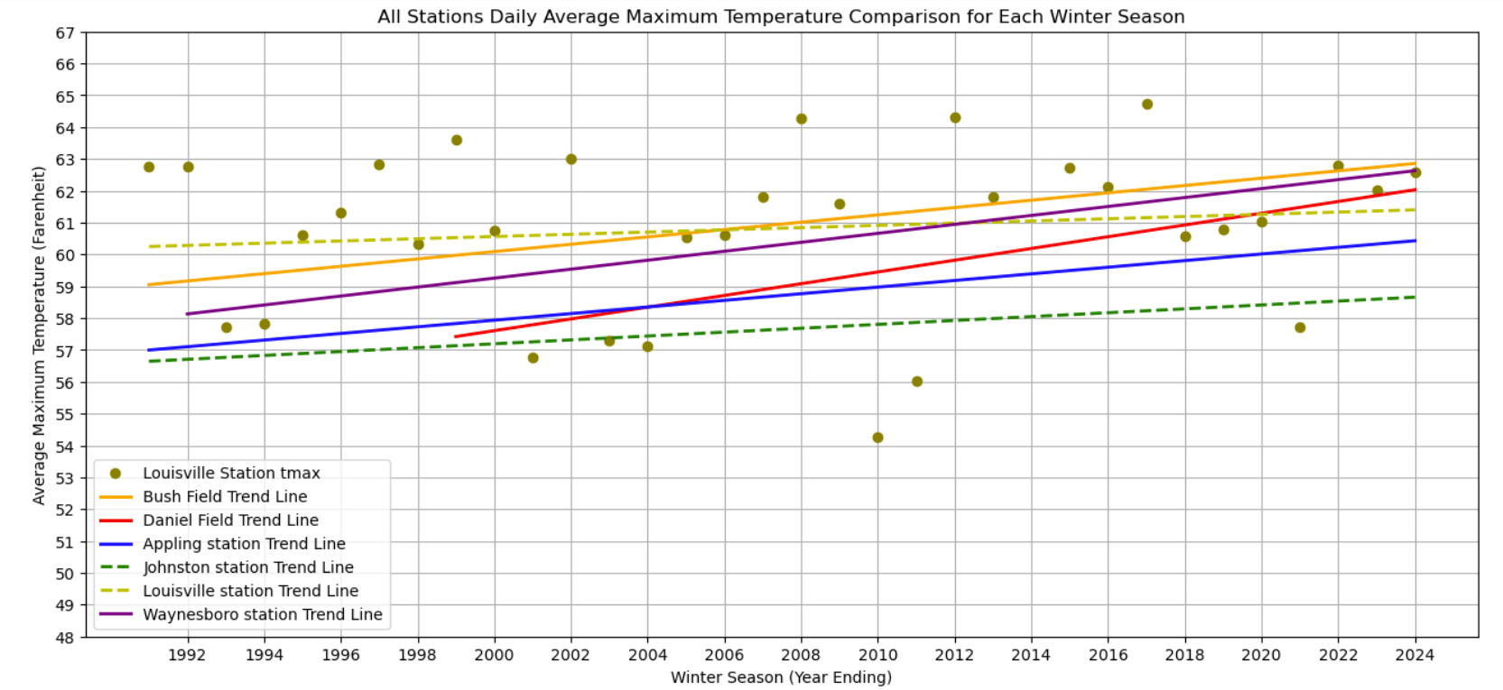

Slide 7
